Slide 1
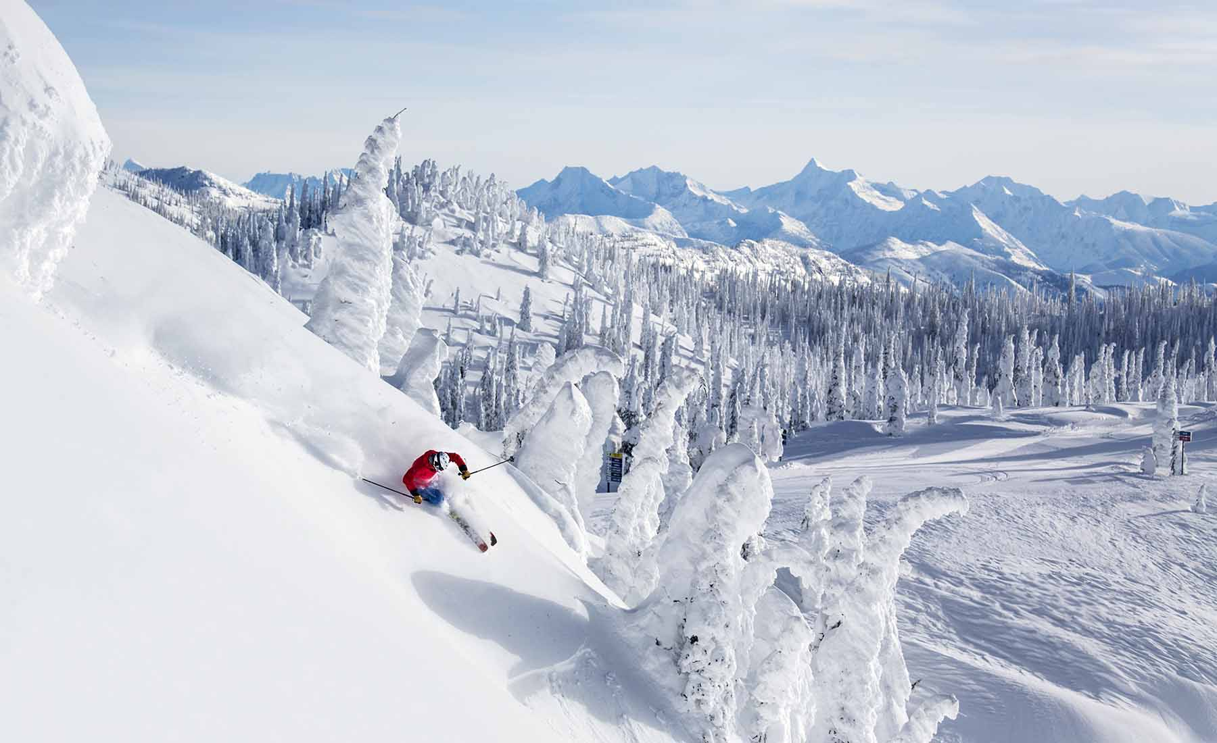
Big Mountain Resort
BY- Harpreet Shoker

Slide 2
Problem Identification
Big Mountain Resort offers views of Glacier National Park and Flathead National Forest, with access to 105 trails and over 350,000 skiers and riders of all levels and abilities to ski or snowboard every year.In addition to 11 lifts the resort has recently installed an additional chair lift to help distribution of visitors resulting in increasing their operating costs by $1,540,000 for the season.The resort needs to find ideas to increase revenue with some changes that will either cut costs without undermining the ticket price or will support an even higher ticket price for the season.

Slide 3
Recommendations and key findings
Big Mountain is in top 90% for key facilities compared to competitors.
Big Mountain Resort’s current ticket price is $81.00 and modelled price is $95.87 with room for $10.30 increase.
Adding a run, increasing the vertical drop by 150 feet and installing an additional chair lift will increase revenue by $3.5M.
Eliminating less popular trails could decrease operating costs without much loss in revenue.

Slide 4
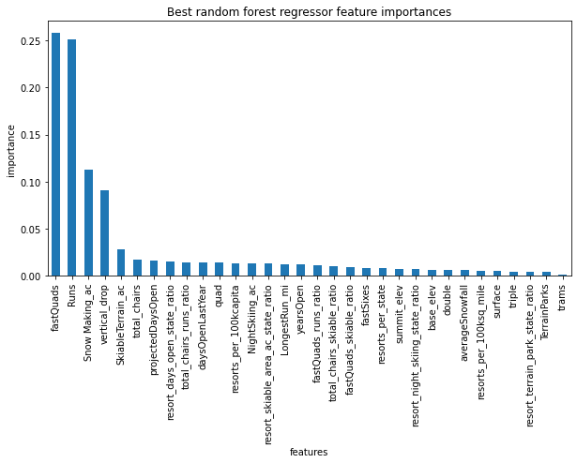
Modeling results and analysis
Features that came up as important in our initial and final model are ranked accordingly:
fastQuads
Runs
Area for Snow Making
Height of the resort's vertical drop

Slide 5
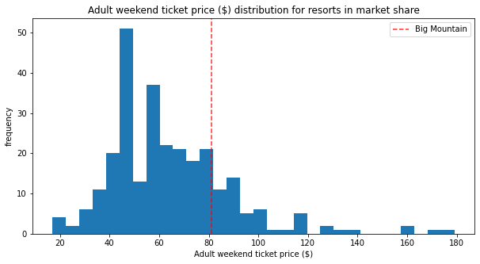
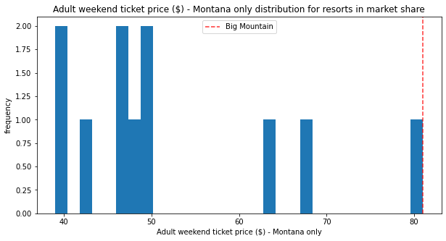
Modeling results and analysis
The plot shows where Big Mountain sits overall amongst all resorts for just other resorts in Montana.
The plot shows where Big Mountain sits overall amongst all resorts for price

Slide 6
Modeling results and analysis
For predicting best ticket price for Big Mountain Resort we first built a pipeline which involves the following steps:
Imputing missing values with median / mean.
Scale the data to zero mean and unit variance
Select the k best features based on univariate statistical tests.
Applying the machine learning model.
Models | Results
Linear Regression Model | Mean Absolute error(MAE) = 11.79
Random Forest Model | Mean Absolute error(MAE) = 9.53

Slide 7
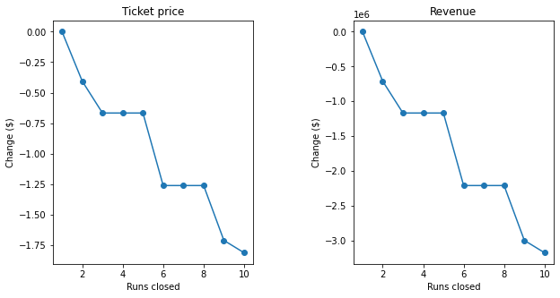
Modeling results and analysis
Scenario | Ticket Price/Revenue
1. Closing upto 10 of least used runs. | -$ 1.81 and -$3.2M
2. Add a run, increase the vertical drop by 150 feet and install an additional chair lift | $1.99 ($3.5M)
3. Same as number 2 but adding 2 acres of snow making cover. | $1.99 ($3.5M)
4. Increase the longest run by 0.2 mile to boast 3.5 miles length, requiring an additional snow making coverage of 4 acres. | No effect ($0)

Slide 8
Summary and Results
Big Mountain Resort’s ticket prices can be increased to $95 to increase seasonal revenue without affecting operating costs. This conclusion comes from applying a random forest model to a dataset of facilities from peer ski resorts across the country
Using our model, we predict that adding a trail to increase vertical drop can further increase revenue by $3.5M, leading to a profit of $2M when accounting for the required chairlift.
We could perform more analysis on less important features that contribute little to the price so cutting costs on these features may reduce the costs.
Closing least used runs might be helpful in reducing operation costs.

Slide 9
THANK YOU

